Slide 1
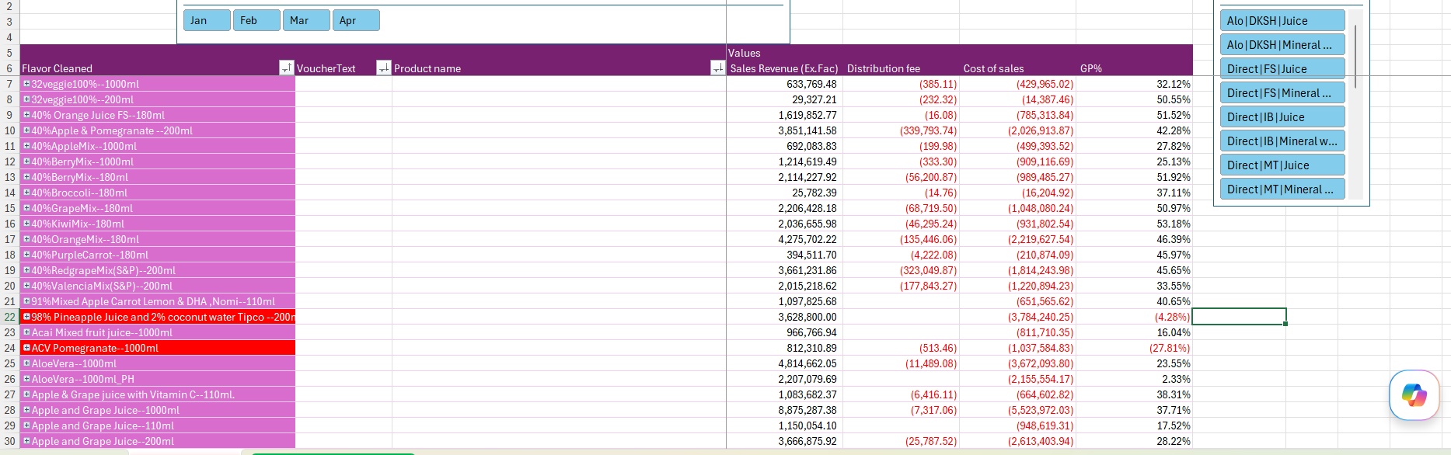
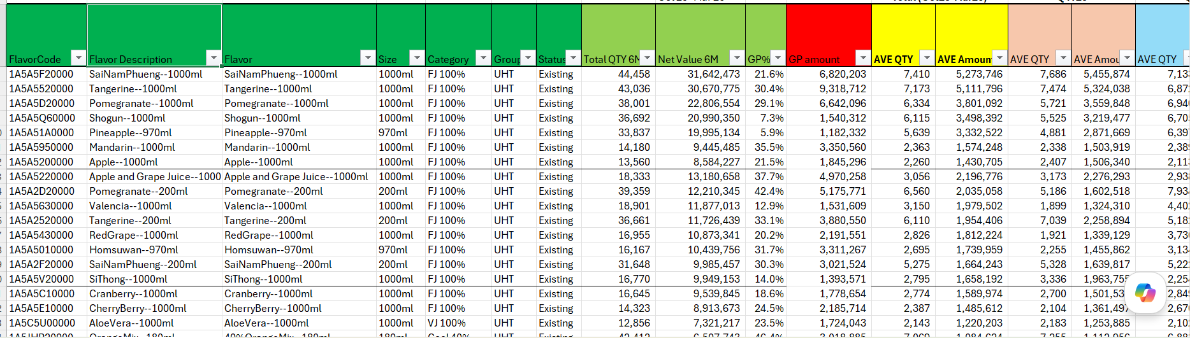
Data Source
เอา Data GP %
จาก Finance ปรับเข้า Product Class
6 mths sale ( Oct – Mar 26 )
Total 1,008 MB
“Category” เป็นแกน มาหมุน analysis

Slide 2
Set 1 – All category / All Channel
Total 1,008 MB
177 SKU

Slide 3
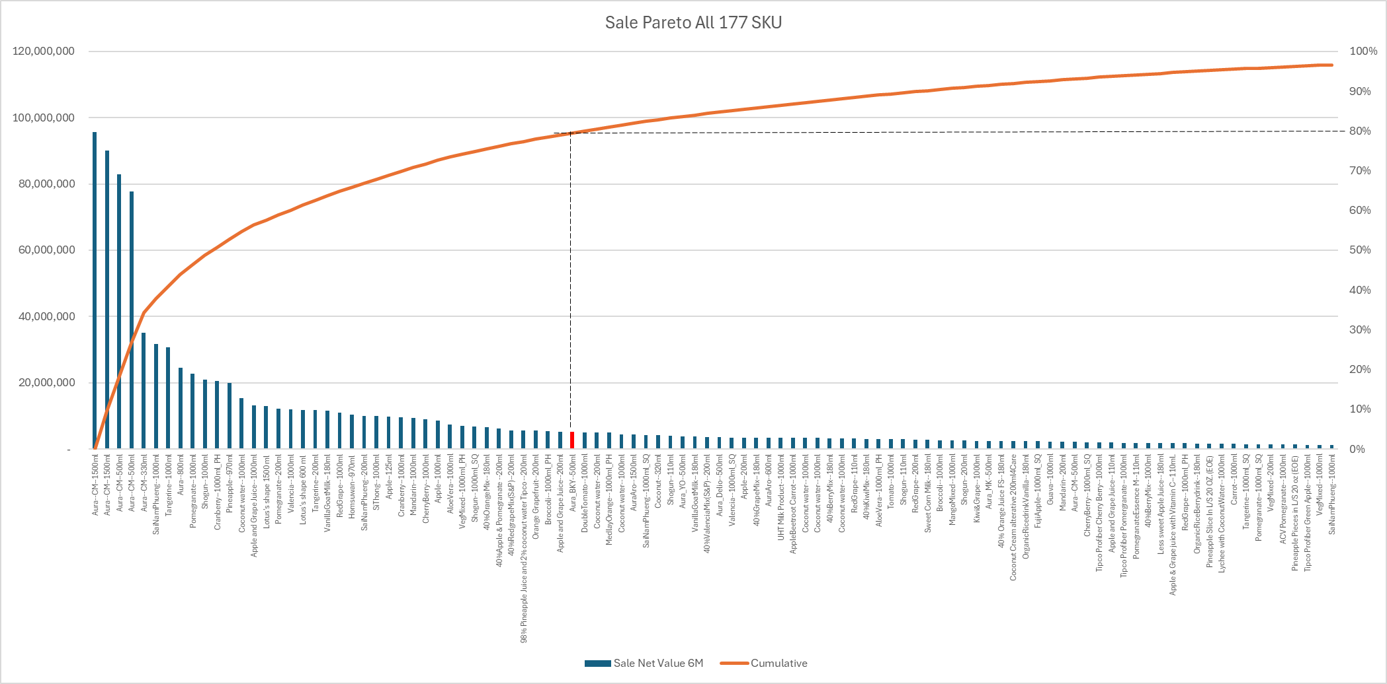
Set 1 – All category / All Channel , Total 1,008 MB, 177 SKU
43 SKU = 80% sale
822 MB (19MB / SKU)
131 SKU = 20% sale
185 MB (1.4 MB / SKU)

Slide 4
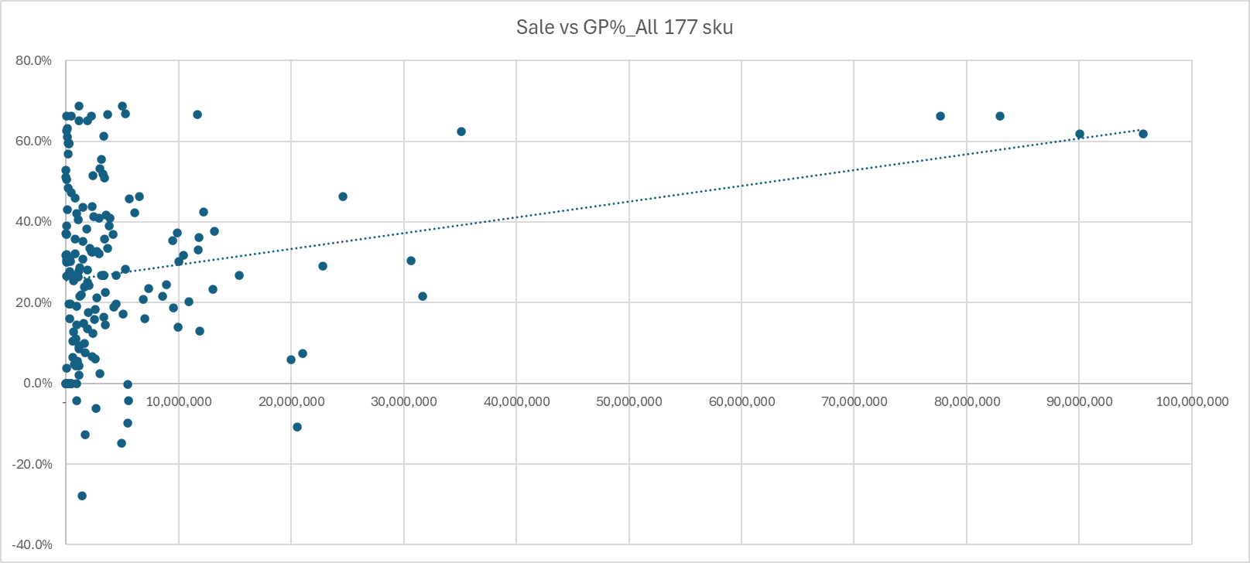
Set 1 – All category / All Channel , Total 1,008 MB, 177 SKU
Cranberry--1000ml_PH

Slide 5
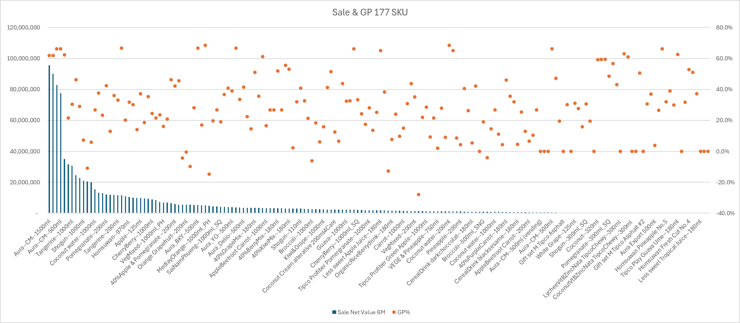
Set 1 – All category / All Channel , Total 1,008 MB, 177 SKU
Avg GP All Product 40%
Avg GP Only Juice 25%
19 SKU
29 SKU
62 SKU
55 SKU
9 SKU

Slide 6
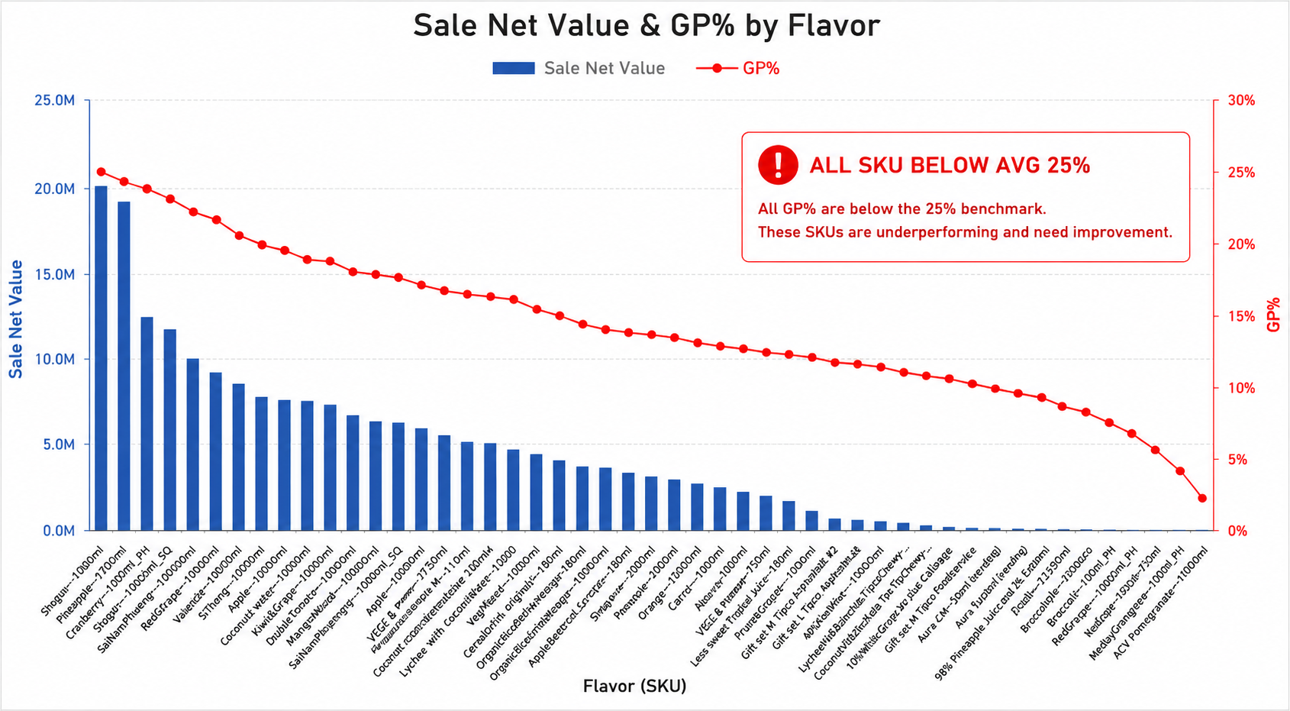
Set 1 – All category / All Channel , Total 1,008 MB, 177 SKU
77 SKU GP < 25% , Contribution to sale 28%

Slide 7
Set 2 – Only Juice 100 / All Channel
(FJ, VJ, SQ, SPK, SFE, OEM Juice 100)
Total 462 MB
90 SKU

Slide 8
Set 1 – All category / All Channel , Total 1,008 MB, 177 SKU

Slide 9
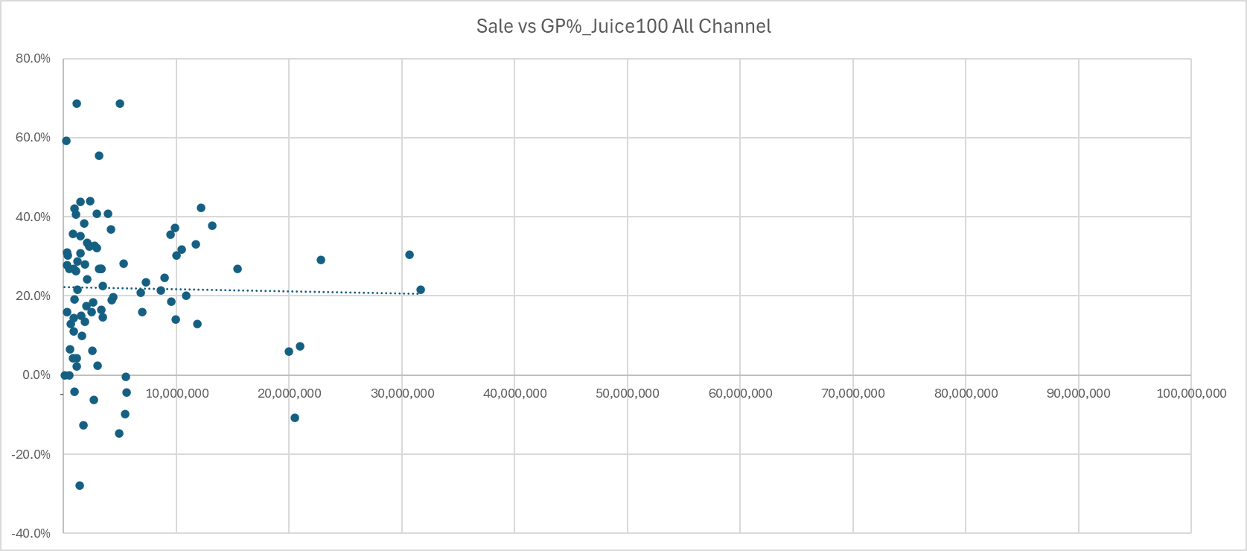
Set 2 – Only Juice 100 / All Channel , Total 462 MB, 90 SKU

Slide 10
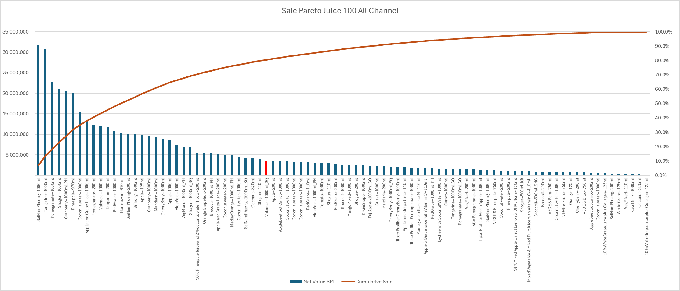
Set 2 – Only Juice 100 / All Channel , Total 462 MB, 90 SKU
30 SKU hit 80% sale, 370 MB
60 SKU 20% sale, 92 MB

